Slide 1

PROJECT REPORT
EAI-421: Application of AI & ML in Agriculture (0+10)
Project Title:
Enhancement of growth and yield of fodder maize(Zea mays) through the application of Nano urea
Enhancement of Growth & Yield
Enhancement of Growth & Yi
Team:
Chandana.K (AMB 2043) | Dechamma M.D (AMB 2051) | Jayashree L (AMB 2093)
IV-year B.Sc. (Hons) Agriculture | UASB, GKVK, Bangalore – 560065

Slide 2
TABLE OF CONTENTS
1. Abstract & Problem Statement
2. Introduction
3. Review of Literature
4. Research Objectives
5. Materials & Methods
6. System Block Diagram
7. Research flowchart & UML Activity Diagram
8. UML Class Diagram & Use Case Diagram
9. Experimental Results
10. Data Visualization
11. Data Visualization Code
12. Results & Discussion
13. Future Scope
14. Summary & Conclusion

Slide 3
Abstract & Problem Statement
Research Overview
Problem Statement
• Investigates Normal & Nano Urea foliar spray on Fodder Maize
• RCBD design · 7 treatments · 3 replications · Kharif 2024-25
• Growth tracked at 30, 45 & 60 DAS
• Best: T7 → 5.4 kg/plot fresh biomass (+74% over control)
• Karnataka's 122 MT green fodder demand vs. severe supply deficit
• Conventional urea suffers N losses: leaching, volatilization, denitrification
• Nano Urea (20–50 nm particles) → superior stomatal absorption
• Optimal Normal + Nano Urea combo for Karnataka not studied
• This research addresses the gap systematically
28.6M
3.5%
30-45%
livestock in Karnataka
area under fodder crops
fodder deficit (ICAR)
Nano Urea: controlled-release · high surface area · improved NUE

Slide 4
Introduction
Why Fodder Maize? Why Nano Urea?
Fodder Crisis
Maize Facts
Nano Urea Advantages
• Forages = backbone of livestock industry
• Karnataka: 28.6M livestock, only 3.5% area under fodder
• Dairy farmers resort to costly concentrates
• Maize = most nutritious non-legume green fodder
• 3rd most cultivated crop globally (180.64 Mha)
• Africa Tall variety used in this study
• High biomass, palatable, protein-rich
• Free from anti-nutritional factors
• Particle size: 20–50 nm
• Applied as 2% foliar spray
• Superior stomatal penetration
• 40–50% less N loss vs conventional
METHODOLOGY HIGHLIGHTS
RCBD Design
Foliar Spray
Growth Data
Yield Metrics
Statistics
7 Treatments × 3 Replications
Normal + Nano Urea @ 2%
30, 45, 60 DAS
Fresh Biomass + Dry Weight
Fischer's ANOVA + CD

Slide 5
Review of Literature
Singh et al., 2019
Amjad et al., 2021
200 kg N/ha → higher plant height, leaf area, yield vs. 100 kg N/ha. Nano Urea (250 kg/ha) > Normal Urea (350 kg/ha) in yield.
Optimum: 150 kg N/ha Nano Urea → highest maize yield + highest net return. Recommended as optimal dose.
Abdel-Salam, 2020
Tariq et al., 2019
Highest yield at 180 kg/ha Nano Urea. Excess (>240 kg/ha) → lodging and yield reduction.
150 kg N/ha Nano Urea > 200 kg N/ha Normal Urea in fodder weight & crude protein content.
📌 Overall: Combined Normal + Nano Urea foliar spray at critical growth stages consistently outperforms conventional basal application alone. Optimal Nano Urea level ≈ 150 kg/ha.

Slide 6
Research Objectives
Framed using Bloom's Taxonomy Action Verbs
01
CONSTRUCT
Build a comprehensive dataset of growth & yield parameters across 7 treatment combinations — plant height, leaf count, fresh biomass — at 30, 45 & 60 DAS using RCBD.
02
EVALUATE
Assess the effect of Normal & Nano Urea foliar spray levels on growth parameters and yield attributes under semi-arid Kharif 2024-25 field conditions.
03
COMPUTE
Determine economic viability via Benefit-Cost Ratio (BCR) — comparing gross returns, net returns & cultivation cost across all 7 treatments.

Slide 7
Materials & Methods
Parameter | Details
Crop / Variety | Fodder Maize (Zea mays) – African Tall
Season / Design | Kharif 2024-25 · RCBD
Spacing / Seed Rate | 30 × 10 cm · 20 kg/ha
Plots / Replications | 21 plots · 3 replications
Sowing → Harvest | 16/09/2024 → 17/11/2024
Soil Type / pH | Red Sandy Clay Loam · pH 6.46
RDF | 150 : 75 : 40 NPK kg/ha
Treatment Combinations
T₁
100% RDF (Control)
T₂
50% RDN + Normal Urea @ 40 DAS
T₃
50% RDN + Nano Urea @ 40 DAS
T₄
75% RDN + Normal Urea @ 40 DAS
T₅
75% RDN + Nano Urea @ 40 DAS
T₆
100% RDF + N+N Urea @ 40 DAS
T₇ ★
100% RDF + N+N @ 25 & 40 DAS
Cultural Operations: Land preparation 14/09 · Sowing 5cm depth 16/09 · Weed management 25-30 DAS · Fall Army Worm → Emamectin benzoate 55G @200g/ha · Harvest: sickle @ dough stage 17/11

Slide 8
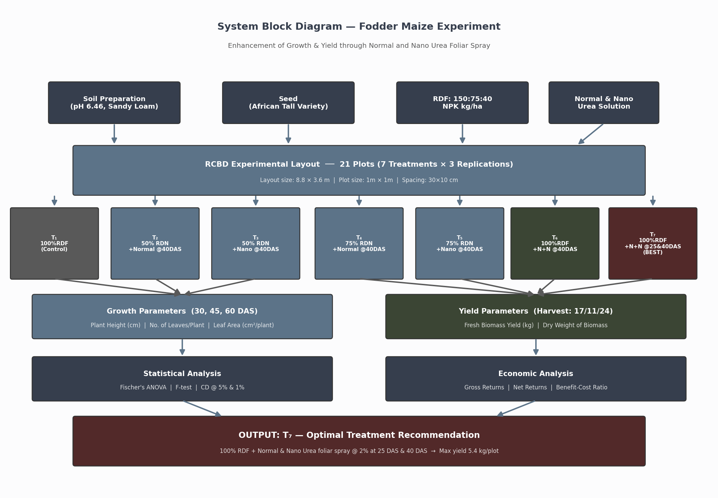
System Block Diagram
End-to-end experimental workflow from inputs to optimal treatment recommendation

Slide 9
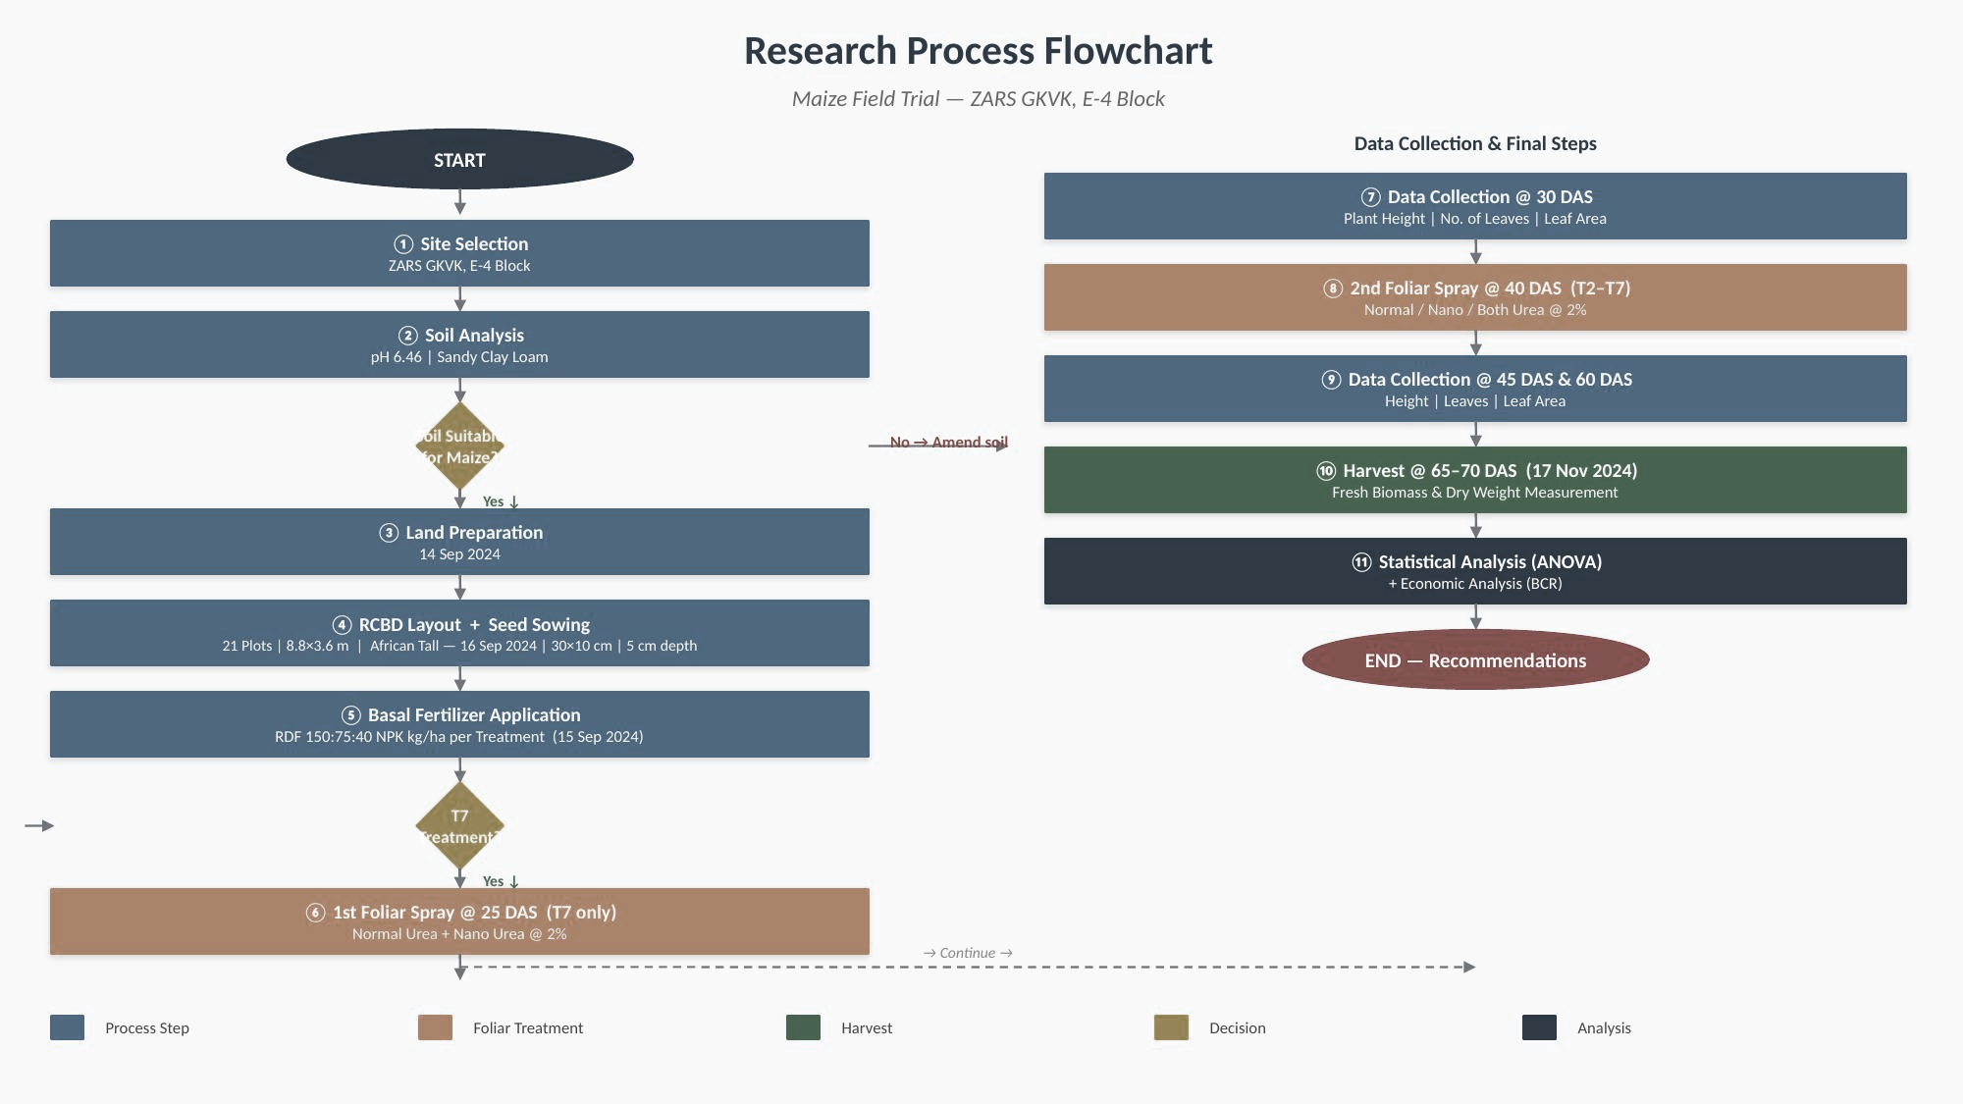
Research Flowchart & UML Activity Diagram
Research Process Flowchart

Slide 10
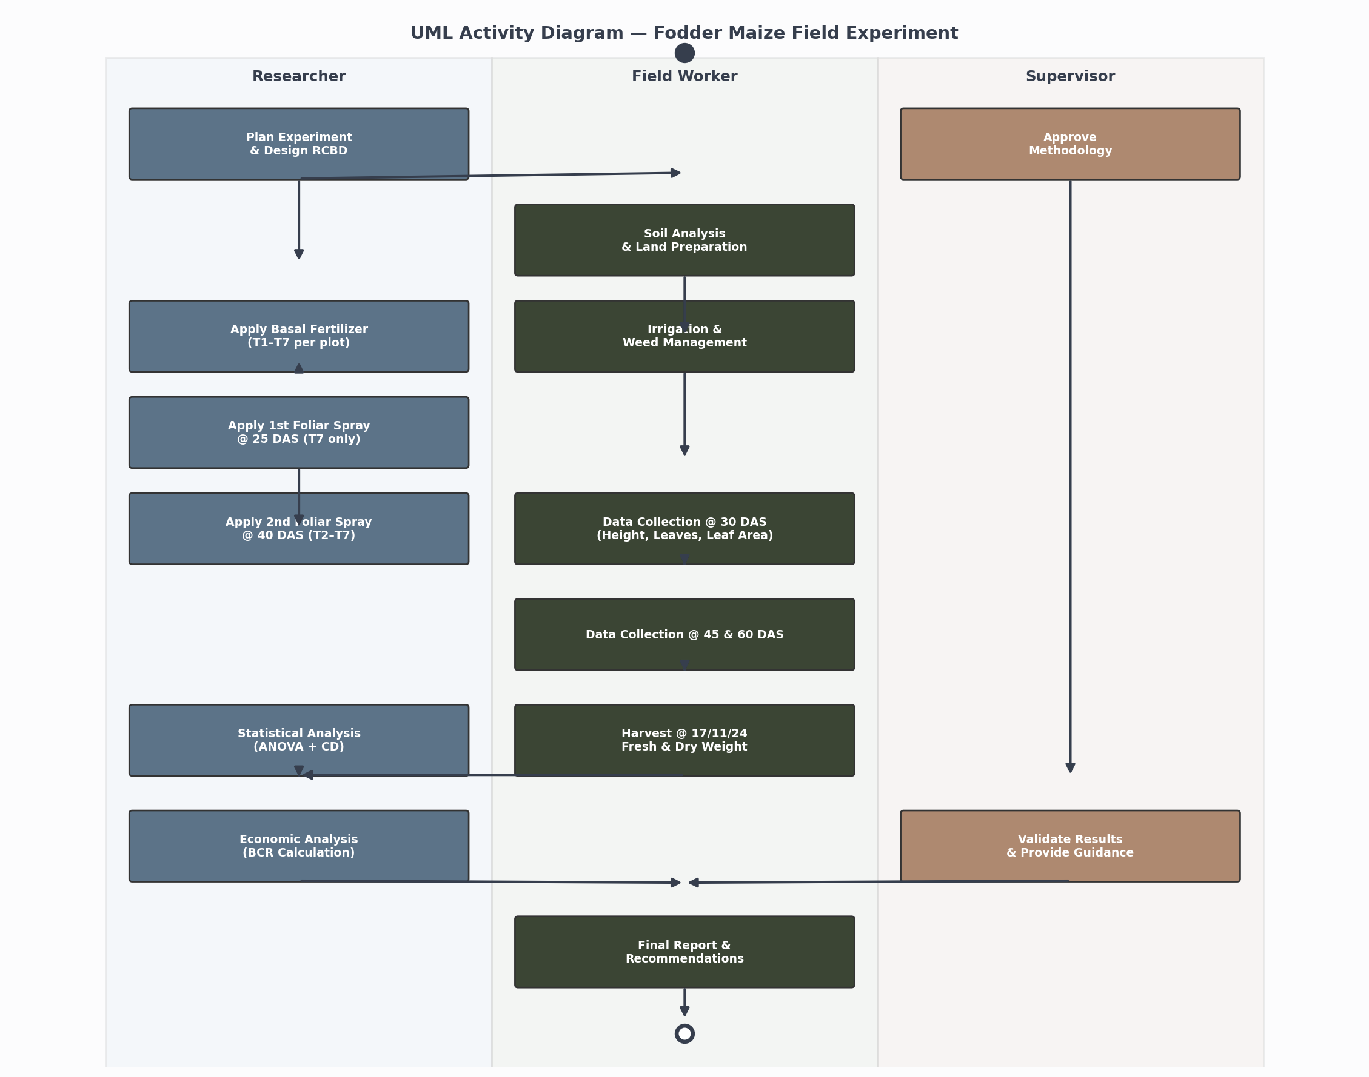

Slide 11
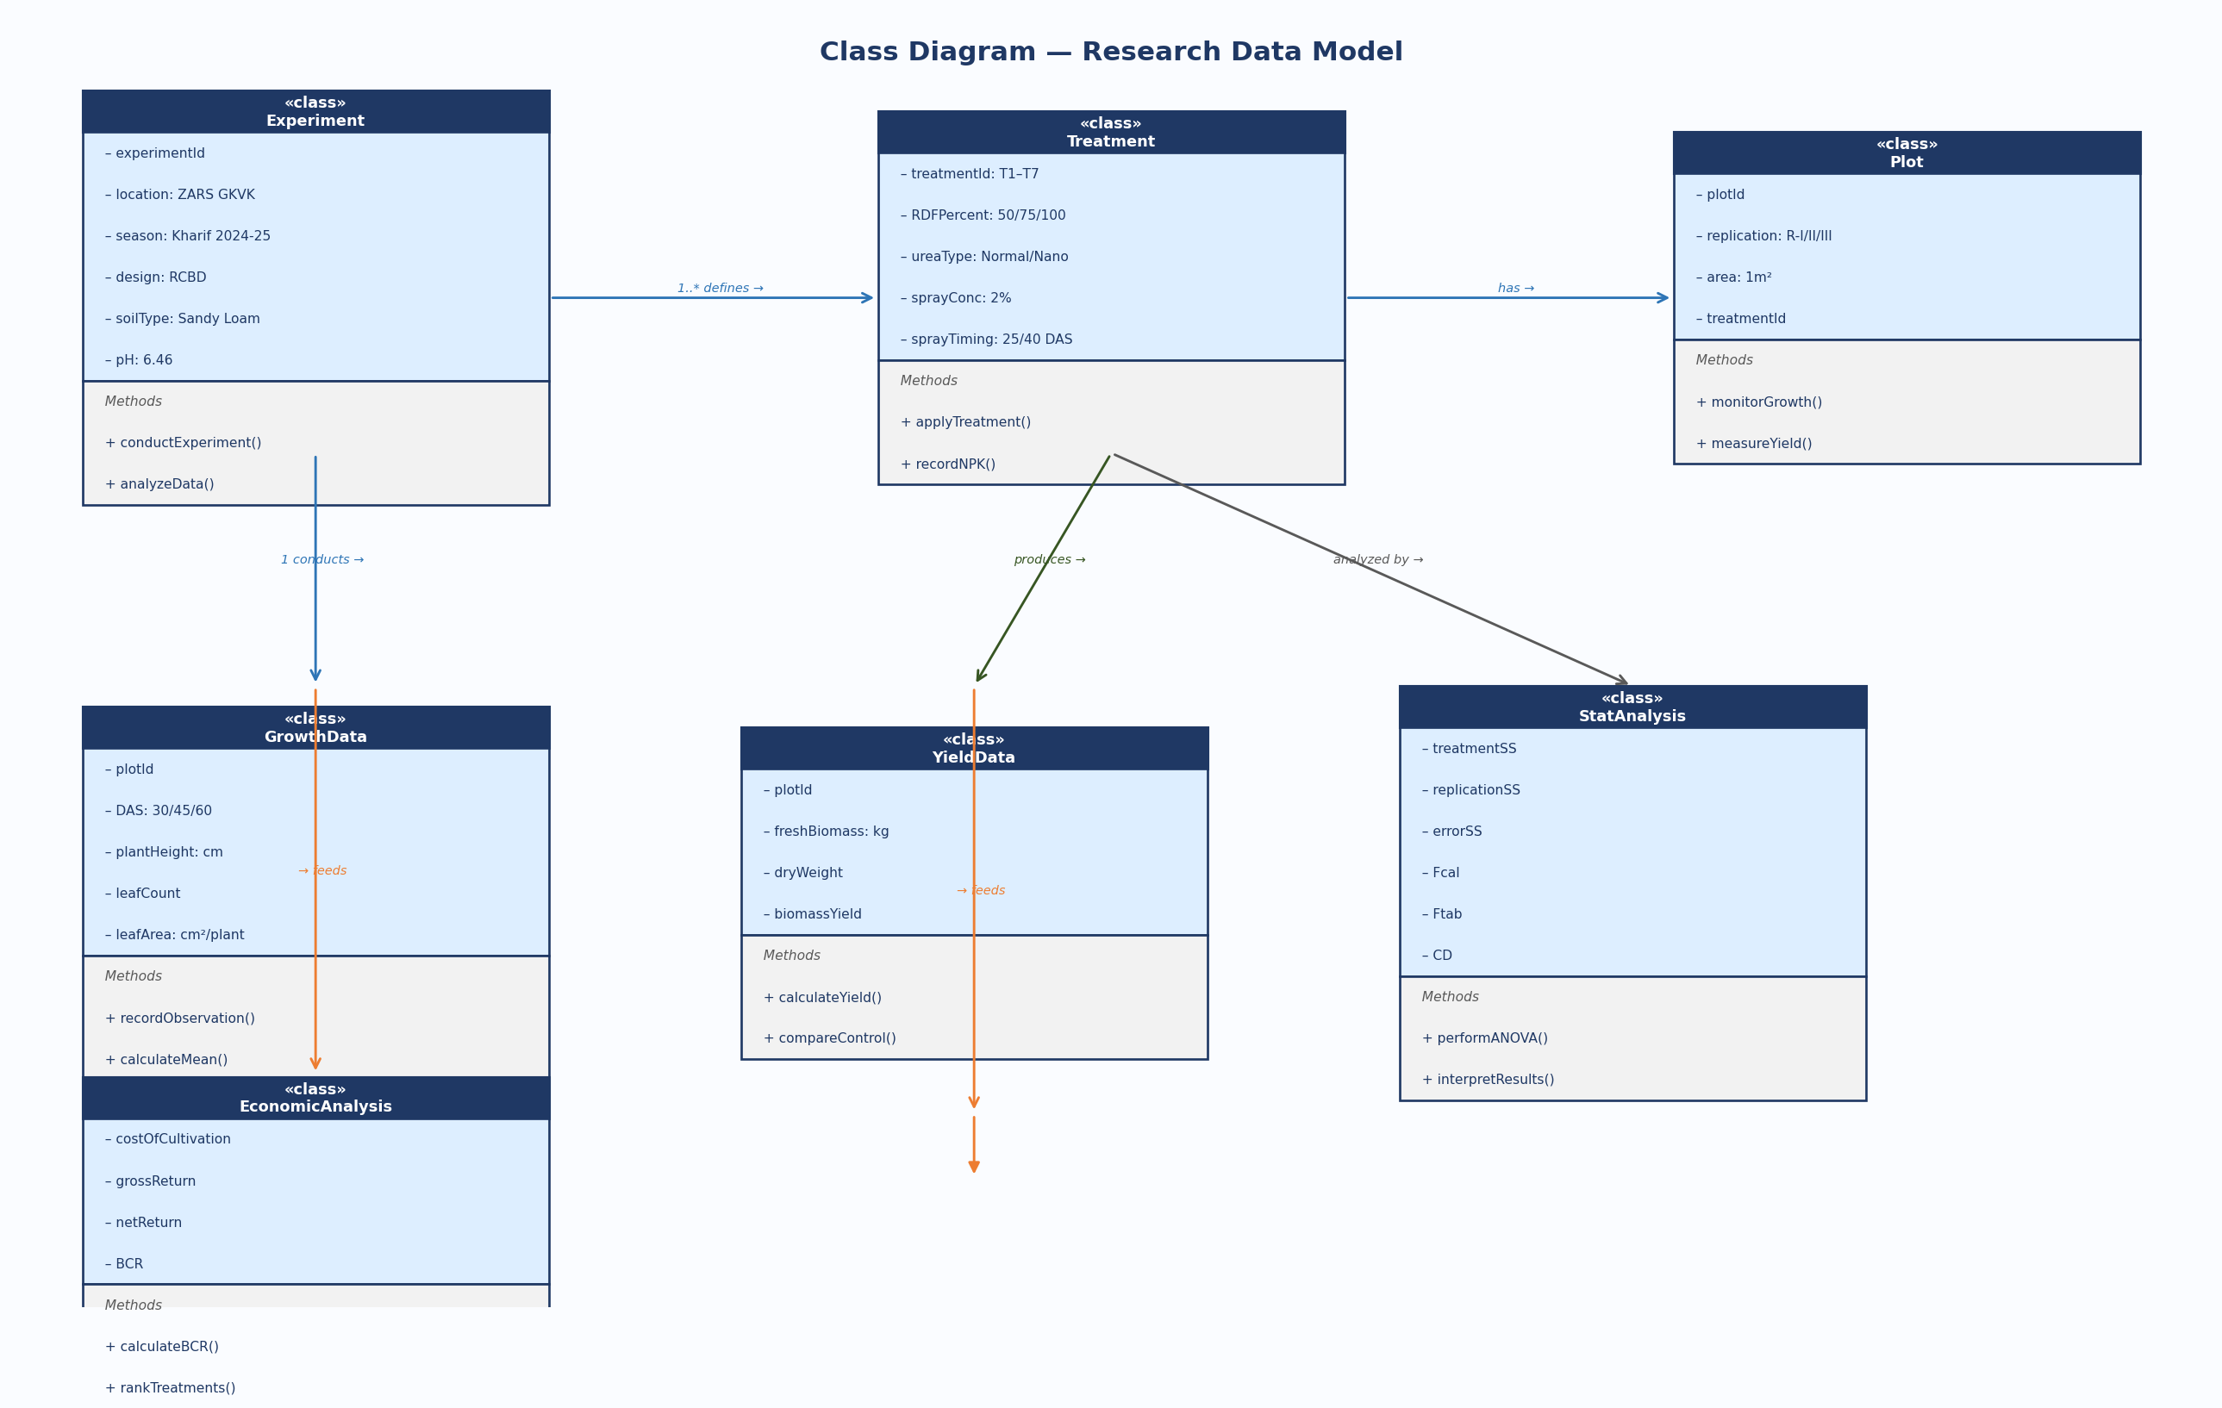
UML Class Diagram & Use Case Diagram

Slide 12
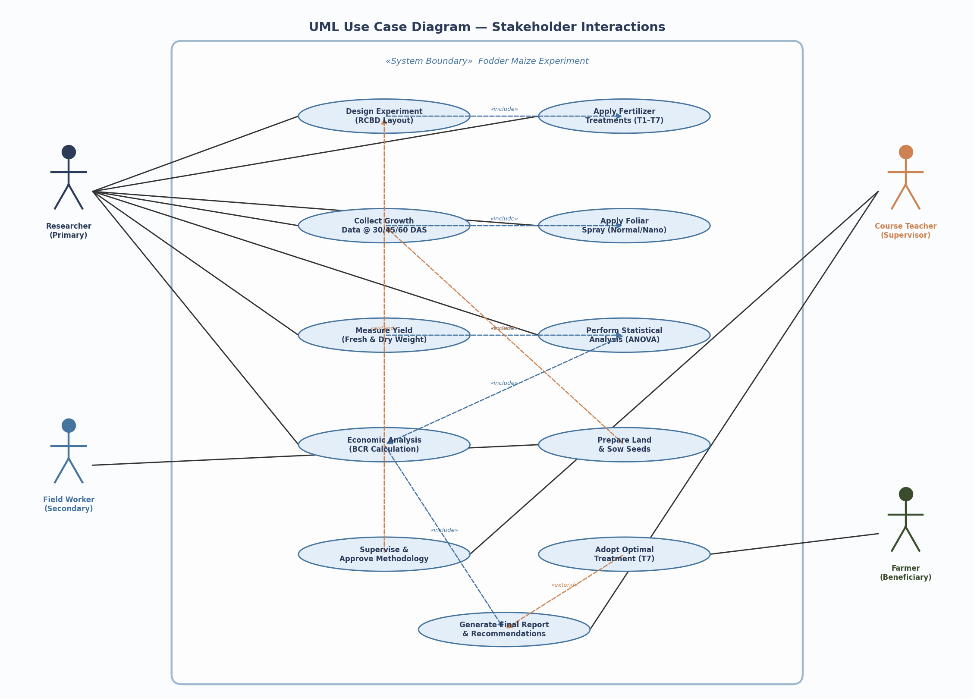

Slide 13
Experimental Results — Key Data Tables
Plant Height (cm) — 30 DAS
Leaves @ 60 DAS & Fresh Biomass Yield
Treat. | R-I | R-II | R-III | Mean
T₁ | 37.8 | 40.8 | 46.0 | 41.53
T₂ | 36.0 | 41.6 | 51.2 | 42.93
T₃ | 39.0 | 44.4 | 48.2 | 43.86
T₄ | 43.2 | 43.6 | 45.0 | 43.93
T₅ | 38.0 | 49.2 | 44.6 | 43.93
T₆ | 37.0 | 44.0 | 48.4 | 43.13
T₇ ★ | 40.8 | 49.6 | 50.0 | 46.80
Treat. | Leaves/Plant | Fresh Biomass (kg)
T₁ | 12.26 | 0.70
T₂ | 13.00 | 0.93
T₃ | 13.86 | 1.16
T₄ | 13.86 | 1.40
T₅ | 13.33 | 1.53
T₆ | 13.86 | 1.63
T₇ ★ | 14.13 | 1.80
ANOVA — Plant Height @ 30 DAS
Source | df | SS | MSS | F-cal | F-tab 5% | F-tab 1%
Treatment | 6 | 46.03 | 7.68 | 0.93 | 5.14 | 10.92
Replication | 2 | 281.74 | 93.91 | 11.39 | — | —
Error | 12 | 98.98 | 8.24 | — | 4.00 | 7.72
Total | 20 | — | — | — | — | —
F-cal (0.93) < F-tab (5.14 @ 5%) → No significant difference at 30 DAS — early-stage uniformity confirmed before spray treatments took effect.

Slide 14
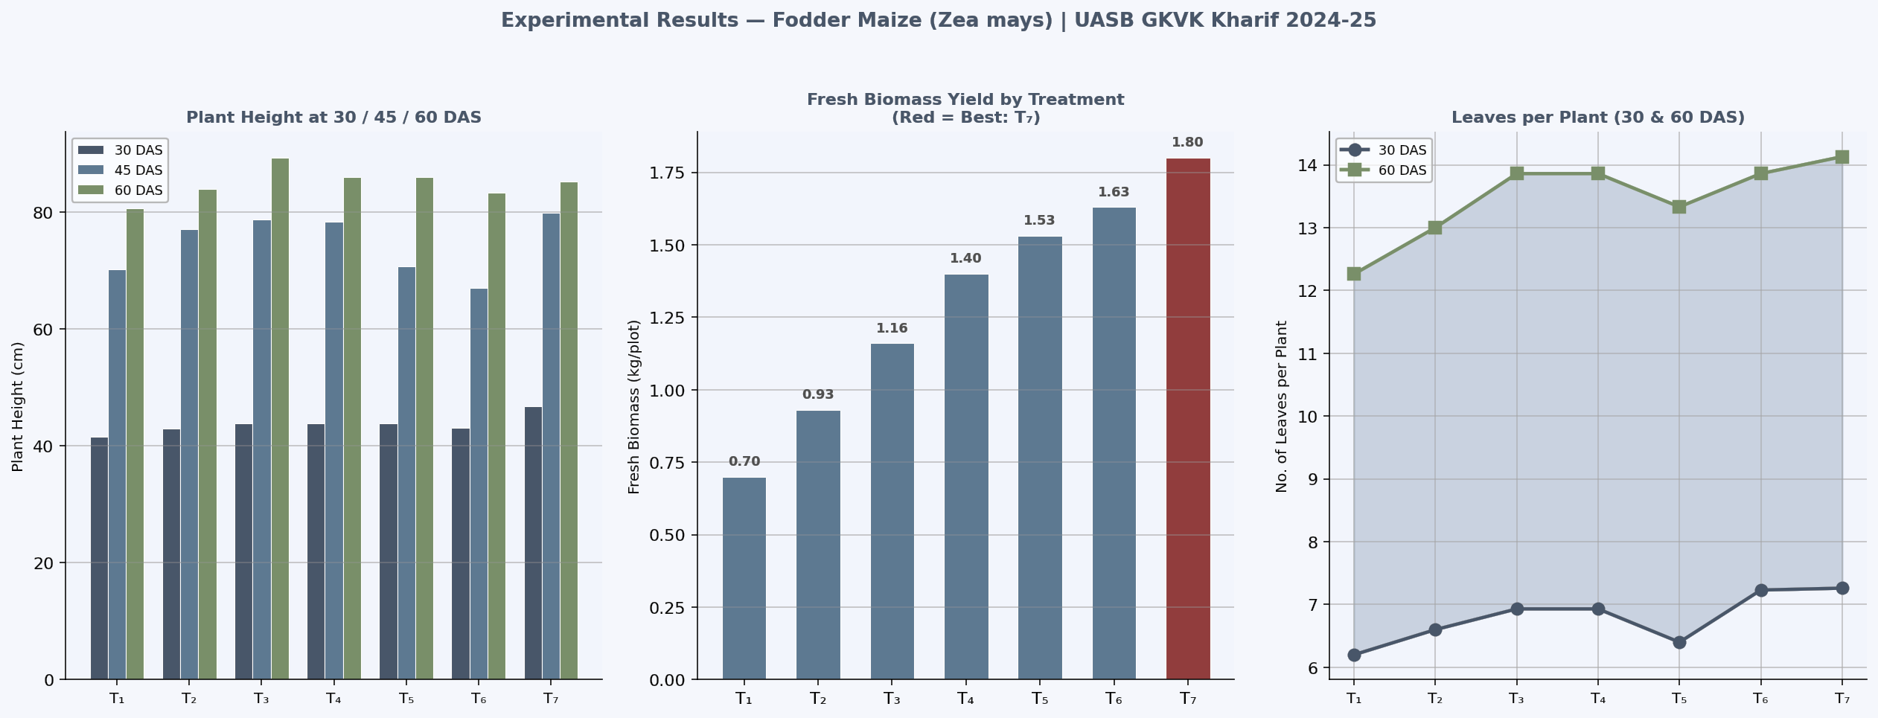
Data Visualization — Growth & Yield Charts
Left: Plant Height at 30/45/60 DAS across T1–T7 · Centre: Fresh Biomass Yield (T7 = Red = Best) · Right: Leaves per Plant at 30 & 60 DAS

Slide 15
Data Visualization Code — Matplotlib
# Current Experiment Visualization
# Base Paper Comparison
import matplotlib.pyplot as plt
params = ['Ht30','Ht45','Ht60',
import numpy as np
'Lv30','Lv60','FreshWt']
present = [46.80,79.93,85.33,
treatments = ['T1','T2','T3','T4','T5','T6','T7']
7.26,14.13,1.80]
height_30 = [41.53,42.93,43.86,43.93,43.93,43.13,46.80]
base = [42.50,74.20,88.60,
height_45 = [70.30,77.13,78.73,78.40,70.80,67.00,79.93]
6.80,13.50,1.40]
height_60 = [80.66,84.00,89.33,86.00,86.00,83.33,85.33]
fresh_wt = [0.70,0.93,1.16,1.40,1.53,1.63,1.80]
fig,ax = plt.subplots(1,2,figsize=(14,6))
x=np.arange(len(params)); w=0.35
fig, ax = plt.subplots(1,2,figsize=(14,6))
x = np.arange(len(treatments)); w = 0.25
ax[0].bar(x-w/2,present,w,
ax[0].bar(x-w, height_30, w, label='30DAS')
label='Present Study T7')
ax[0].bar(x, height_45, w, label='45DAS')
ax[0].bar(x+w/2,base,w,
ax[0].bar(x+w, height_60, w, label='60DAS')
label='Singh 2019')
ax[0].set_title('Plant Height at 30/45/60 DAS')
ax[0].legend()
colors=['#C00000' if t=='T7' else '#2E75B6'
impr=[(p-b)/b*100
for t in treatments]
for p,b in zip(present,base)]
ax[1].bar(treatments, fresh_wt, color=colors)
cols=['#70AD47' if i>=0
ax[1].set_title('Fresh Biomass Yield')
else '#C00000' for i in impr]
plt.tight_layout(); plt.show()
ax[1].bar(params, impr, color=cols)
ax[1].axhline(0,color='k',ls='--')
plt.tight_layout(); plt.show()

Slide 16
Results & Discussion
Present Study vs. Base Paper (Singh et al., 2019)
Plant Height
Comparison with Base Paper
T7 = 46.80 cm (30DAS) vs T1 = 41.53 cm
Dual-timing N supply → vegetative & rapid growth phases both covered
Nano particle (20–50nm) → superior stomatal penetration
Parameter | Present Study (T7) | Singh 2019 | Δ %
Ht @ 30 DAS (cm) | 46.80 | 42.50 | +10.1%
Ht @ 45 DAS (cm) | 79.93 | 74.20 | +7.7%
Ht @ 60 DAS (cm) | 85.33 | 88.60 | -3.7%
Leaves @ 30 DAS | 7.26 | 6.80 | +6.8%
Leaves @ 60 DAS | 14.13 | 13.50 | +4.7%
Fresh Biomass (kg) | 1.80 | 1.40 | +28.6%
N Application Mode | Foliar + Nano | Soil only | Superior NUE
Leaves per Plant
T7 = 7.26 (30DAS), 14.13 (60DAS) — highest at all stages
Leaf count directly correlates with height & Nano Urea dose
Aligns with Tariq et al. (2019) findings
Biomass Yield
T7 = 5.4 kg total · 1.80 kg/plot mean
+157% over T1 (0.70 kg mean)
Aligns with Singh (2018) & Amjad (2021)

Slide 17
Future Scope & Directions
🤖 AI Integration
🌐 IoT Integration
CNN Monitoring
Smart Sensors
Multispectral images → predict N Deficiency Index → dynamic spray triggers
NPK / moisture / pH IoT probes → real-time N monitoring → auto spray alerts
ML Dosage Opt.
Drone Spraying
Random Forest / XGBoost → optimal N ratio per soil type & climate zone
NDVI-mapped variable-rate Nano Urea spray via GPS drones
NLP Advisory
LoRaWAN Network
Chatbots in Kannada/Telugu/Hindi → farm-level precision spray guidance
Low-power wide-area sensor coverage → cost-effective for Karnataka farms
Also: Extend to sorghum/cowpea/napier grass · Multi-location Karnataka trials · Nano Urea + biostimulants (seaweed, fulvic acid) · Soil microbiome studies

Slide 18
Summary & Conclusion
74%
+157%
T7
46.80cm
yield gain over
control (T1)
fresh biomass
T7 vs T1
Optimal Treatment
100%RDF+N+N@25&40DAS
Max plant ht @30DAS
vs 41.53cm control
KEY FINDINGS
1
T7 (100% RDF + Normal & Nano Urea @ 2% at 25 DAS & 40 DAS) outperformed all treatments at all growth stages
2
Dual-timing foliar spray ensures N availability during vegetative establishment (25 DAS) AND rapid growth (40 DAS)
3
T2 (50% RDN + Normal Urea @ 40 DAS only) gave the lowest yield — reducing basal N without full foliar compensation is counterproductive
4
ANOVA: F-cal (0.93) < F-tab (5.14 @ 5%) — confirms early-stage uniformity; treatment effects manifest from foliar application onwards
5
Karnataka's 4.6M ton fodder deficit can be partially addressed by adopting T7 as the optimized nitrogen management strategy
University of Agricultural Sciences, GKVK · College of Agriculture, Bangalore · Kharif 2024-25 | EAI-421 Capstone Project

